Slide 1
AWS ARCHITECTURE

Slide 2
Global network of AWS regions
AWS offers the largest global footprint in the market. No other cloud provider offers as many regions with multiple Availability Zones
81 Availability Zones
25 Launched Regions
PLANNING 21 more Availability Zones and 7 more AWS Regions in Australia, India, Indonesia, Israel, Spain, Switzerland, and United Arab Emirates (UAE).
These AZs offer you an easier and more effective way to design and operate applications and databases, making them more highly available, fault tolerant,.

Slide 3
,.
Regions
Availability Zones (AZs)
Edge Locations
Regional Edge Caches

Slide 4
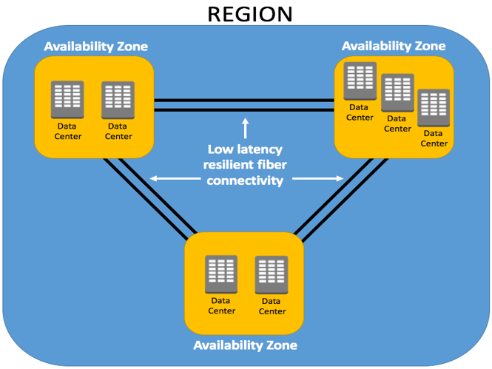
Regions
AWS has the concept of a Region, which is a physical location around the world where we cluster data centres.
AWS Regions each have multiple AZs that are physically separated and isolated from each other

Slide 5
Availability Zones (AZs)
Availability Zones are distinct locations within an AWS Region that are engineered to be isolated from failures in other Availability Zones.
An availability zone is a logical data center in a region available for use by any AWS customer. .
Adleast 3 AZ's in one region

Slide 6
Edge Locations @ Regional Edge Caches
Edge locations are CDN(Content delivery network) ex: Cloud front
Currently there are more than 205 edge locations
For ex :website hosted in US and from India we are accessing that without buffering the website videos will play 1st time will be slow next time it will save in the nearest edge location users in that edge location can able to view the contents fastly.
Regional edge cache caches the update if any modification take place and split it into edge locations.

Slide 7
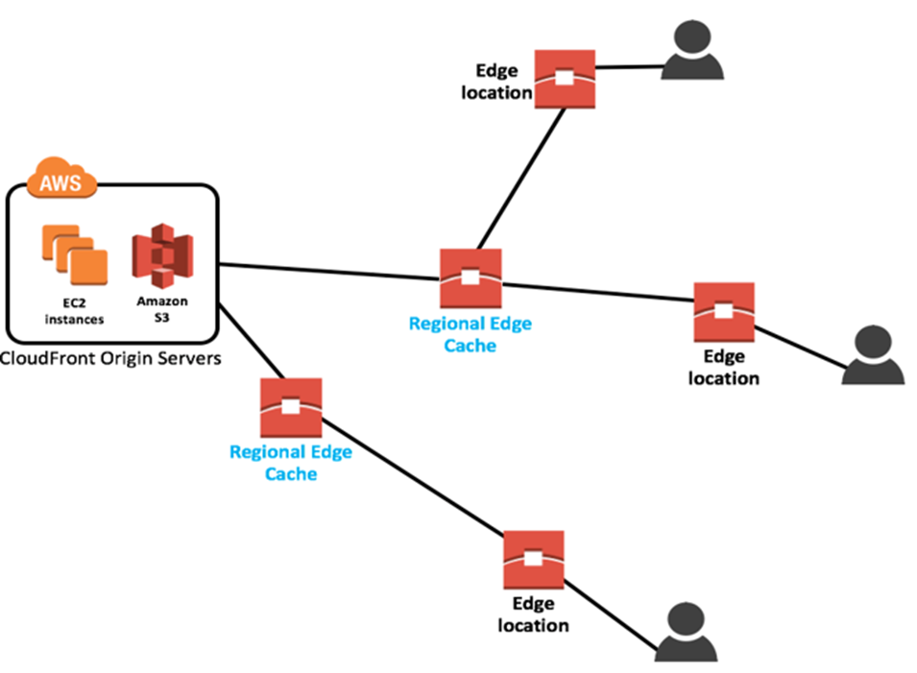

Slide 8
Key Benefits
Performance : Performance is a key driver of the design of the AWS Global Infrastructure. 216 POP to get more speed.
Availability: even in the event of power outages, Internet downtime, floods, and other natural disasters
Security : Our infrastructure is monitored 24/7 Customers can build on the most secure global infrastructure, knowing they always own their data, including the ability to encrypt it, move it, and manage.
Scalability :The AWS Global Infrastructure enables companies to be extremely flexible and take advantage of the conceptually infinite scalability of the cloud.
Low Cost : By deploying and delivering their workloads in the AWS Cloud, a 2018 IDC research report indicates 51% lower cost of operations, 62% more efficient and 90% less staff time to deploy new storage.

